Slide 1
ADS ML – Week 5 Support Vector Machines & Evaluation Metrics

Slide 2
Goals: At the end of this lesson …
You understand SVM.
You know what cross-validation implies.
You have a basic understanding of classification metrics.
And are able to apply these concepts to an image dataset.

Slide 3
Udacity MOOC
Our Lesson | MOOC
4 | 0
5 | 2
6 | 1
7 | 3
8 | 6
9 | 8
10 | 11, 12
11 | 11, 12
12 | -
Intro to Machine Learning (Udacity MOOC)
https://www.udacity.com/course/intro-to-machine-learning--ud120
Nice site with datasets (thanx Stefan):
http://archive.ics.uci.edu/ml/​

Slide 4
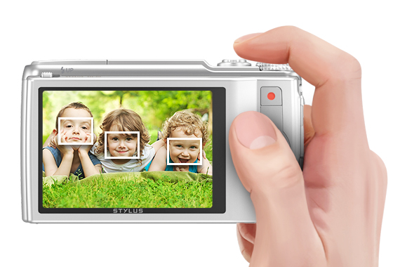
Machine Learning Products
With Machine Learning you can create amazing products & services!
In this course you will program face recognition in IPython with SVM.
Face recognition

Slide 5
Google Car Example Again
bumpy
Google car module: Driving fast (+) or slow (o) depends on terrain characteristics.
Which line would you pick? {A, B, or C}
Why?
C
o
o
B
o
o
o
A
+
roughness
o
o
+
+
+
+
o
+
+
smooth
flat
slope
steep

Slide 6
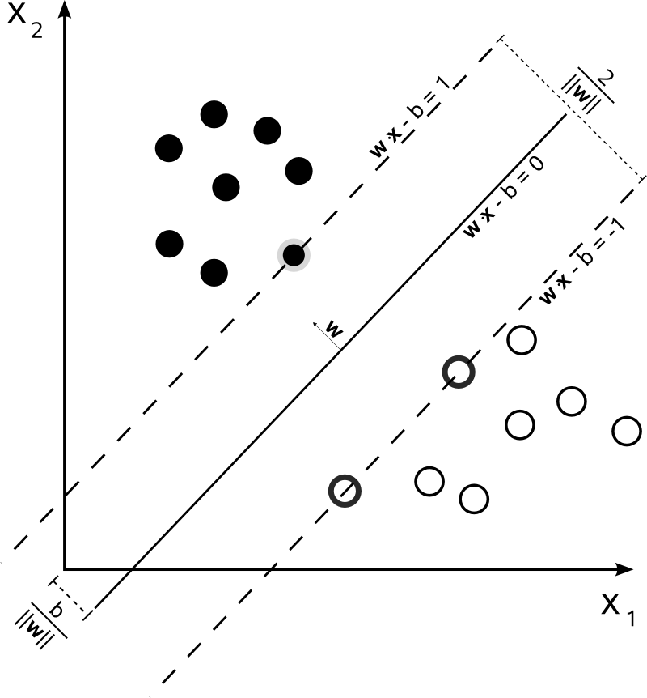
Linear Support Vector Machines 1
Compute the best linear boundary surface or hyperplane (line in 2D).
Invented by Vladimir Vapnik (1993).
The margin, distance between the hyperplane and the closest datapoints, is maximized.
The closest datapoints are called support vectors.
They perform good in a high-dimensional feature space (e.g. for image classification)
Notes:
SVM’s are rather new, very popular and powerful

Slide 7
Linear Support Vector Machines 2
This is what SVM does in practice!
It finds the line which maximizes the margin of support vectors (= closest data points marked with ).
Line B is indeed a good choice, because it separates the data-points ‘best’.
Large margin!
o
o
B
o
o
o
+
o
o
+
+
+
+
o
+
+
Notes:
This maximum-margin separator is determined by a subset of the datapoints.
Datapoints in this subset are called “support vectors”.
It will be useful computationally if only a small fraction of the datapoints are support vectors, because we use the support vectors to decide which side of the separator a test case is on.

Slide 8
Linear Support Vector Machines 3
Hyperplane with small margin.
denotes the support vectors
Line A is a bad choice.
o
o
o
o
o
A
+
o
o
+
+
+
+
o
+
+

Slide 9
Linear SVM – Math
change → rotate hyperplane
change → shift hyperplane
N-Dimensional case
Linear classifier:
Hyperplane:
Parameters and b are optimized (“learned”) based on training data.
Decision rule:
Minimize:
Under condition
b
o
o
o
o
x₂
+
o
o
b
+
+
+
+
o
+
+
x₁
Notes:
Task: Find optimal value of w and b
The parameter w and b control the hyperplane and thus the decision rule!
On blackboard: N = 2 becomes a line, N = 3 becomes a plane!
Condition means: all points are lying on the good (right) side of the hyperplane

Slide 10
Linear SVM – Code
Import sklearn stuff
Create classifier
Fit it with training data
Use clasiifier to do predictions on test set
Evaluate classifier, measure accuracy (of test set!)
from sklearn.svm import SVC
from sklearn.metrics import accuracy_score
clf = SVC(kernel="linear")
clf.fit(features_train, labels_train)
pred = clf.predict(features_test)
acc = accuracy_score(pred, labels_test)
Notes:
All sklearn classifiers follow the same pattern!

Slide 11
Non-linear SVM 1 – Problem
[Show circular distribution of data points in scatter plot]
It is really hard to define a linear boundary surface in this case!

Slide 12
Non-linear SVM 2 – Example
Now try new feature: χ = x1² + x2² (= distance to the origin)
[Show circular distribution of data points in scatter plot]
x1
SVM
x2
label
χ
Notes:
Also make example abs(x1) = mirror wrt y-axis.

Slide 13
Non-linear SVM 3
x1, x2
Non-linear decision boundary
x1, x2, x3, x4, x5
Solve problem (with linear SVM)
Change input to higher dimensional space
Transform back

Slide 14
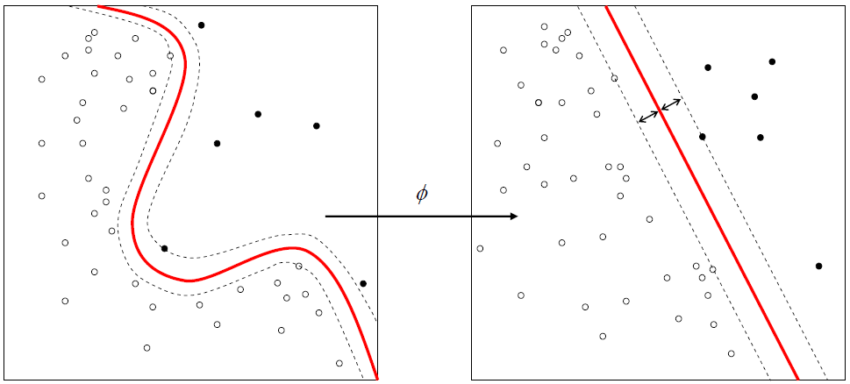
Non-linear SVM 4 – Kernel Trick
Most real-world problems are not linear separable.
Transformation:
Polynomiale kernel
Radial basis function kernel (RBF)
This is called the “kernel trick”

Slide 15
Non-linear SVM 5 – Code & Hyperparameters
Arguments that you pass when you create the classifier.
clf = SVC(kernel=“rbf“, C = 100.0, gamma = 1.0 )
Kernel – { linear, poly, sigmoid, rbf }
C – trades off misclassification of training samples against simplicity of the decision surface. A low C makes the decision surface smooth, while a high C aims at classifying all training samples correctly by giving the model freedom to select more samples as support vectors.
Gamma - defines how far the influence of a single training example reaches, with low values meaning ‘far’ and high values meaning ‘close’. Gamma can be seen as the inverse of the radius of influence of samples selected by the model as support vectors.

Slide 16
SVM Summary
Works really well in many complicated domains (image processing)
Work when number of features > number of observations.
Slow when dataset is very large.

Slide 17
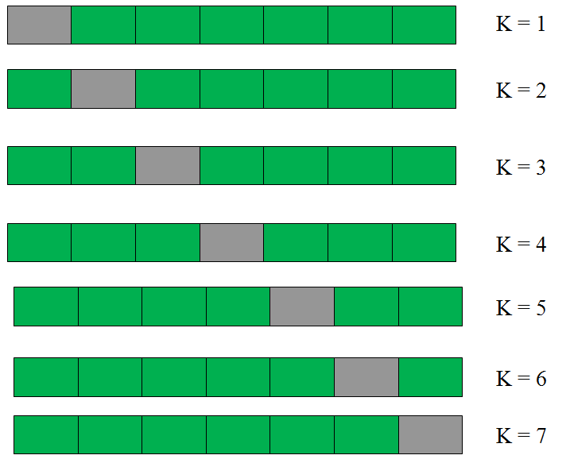
K-fold Cross Validation
Depending on specific partition in train and test data (made randomly), we can get either better or worse results.
Cross-validation avoids a particular train-test split, thereby producing a more realistic overall model score.
Partition the dataset into k different subsets (folds).
Create k different models by training on k-1 subsets and testing on the remaining subset.
Measure the performance on each of the k models and take the average measure.

Slide 18
Classification Metrics – Accuracy
What is the accuracy of the linear model on this test set?
o
o
o
o
o
+
o
+
o
o
o
o
+
+
+
+
+
o
+
+
o
+
+
+
+

Slide 19
More on Classification Metrics
Suppose:
I have 99 + and 1 o.
What is the accuracy of the model that always predict +?
Is accuracy on the test the only measure that matters?
+
+
+
+
+
+
+
+
+
+
+
+
+
+
+
+
+
o
+
+
+
+
+
+
+
+
+
+
+
+
+
+
+
+
+
+
+
+

Slide 20
Precision and Recall
Accuracy = (TP + TN) / (TP + FP + FN + TN)
Precision = TP / (TP + FP)
Recall = TP / (TP + FN)
+
+
o
o
o
o
o
+
o
Prediction
setosa not setosa
+
o
o
o
o
+
o
o
+
+
TP
FN
+
+
o
Reality
not setosa setosa
+
+
o
+
FP
TN
+
+
+
+

